Slide 1
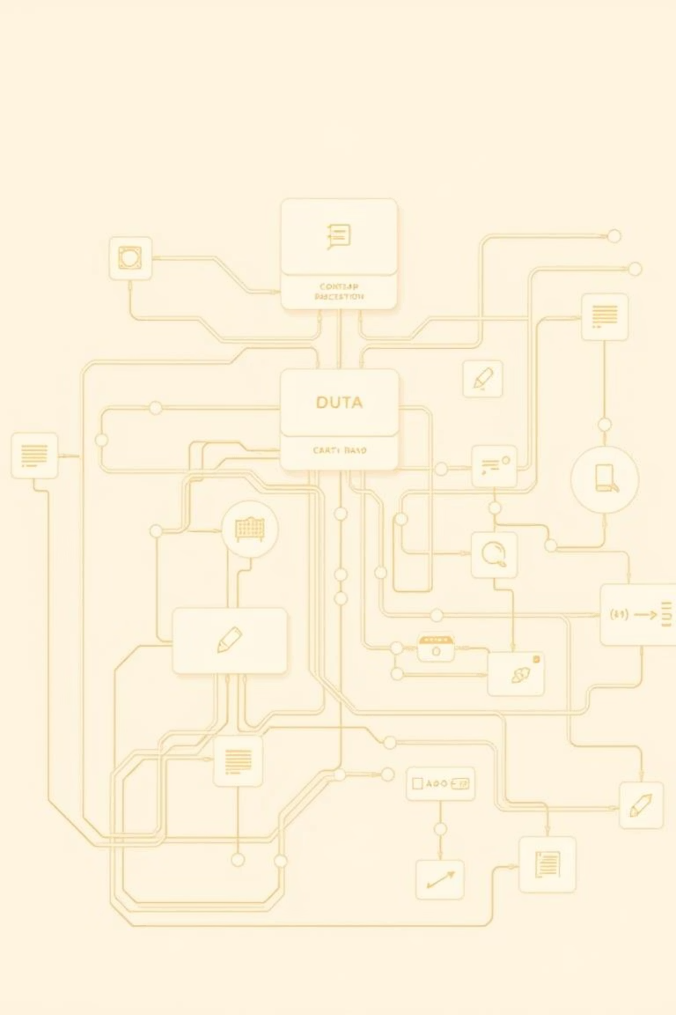
Advanced Personal Finance Tracking System:
An innovative, scalable platform designed to empower users with seamless, real-time financial insights.

Slide 2



Our Narrative: Empowering Financial Clarity
In today's fast-paced world, managing personal finances can be overwhelming. Our system aims to simplify this, offering a comprehensive, real-time solution for tracking, analysing, and optimising financial health. This presentation outlines the cutting-edge technologies that power our platform, ensuring security, scalability, and an exceptional user experience.
Real-time Insights
Enhanced Security
Seamless Integration
Gain immediate clarity on spending and savings.
Protect sensitive financial data with robust measures.
Connect various financial accounts effortlessly.

Slide 3

Backend Foundation: Supabase & Prisma
Supabase: Open-source backend-as-a-service providing real-time database, authentication, and storage — enabling rapid development and scalability.
Prisma: Modern ORM for type-safe database access, simplifying complex queries and ensuring data integrity.
Together, they form a robust, scalable backend that securely manages user data and financial transactions.
Supabase provides the PostgreSQL database, real-time subscriptions, and RESTful APIs out-of-the-box. Prisma streamlines database interactions with its intuitive ORM, ensuring type safety and robust data models. This powerful duo allows us to focus on delivering features rather than managing complex infrastructure.

Slide 4



Unlocking Insights with AI: Gemini AI
Our system leverages the power of Gemini AI for advanced financial analysis and personalised recommendations. Gemini AI processes transaction data to identify spending patterns, predict future financial trends, and offer actionable advice.
Smart Budgeting
Predictive Analytics
Personalised Advice
AI-driven suggestions for optimising spending habits.
Forecast future cash flow and potential savings.
Tailored recommendations based on individual financial goals.
By integrating Gemini AI, we move beyond basic tracking, providing users with a proactive financial assistant.

Slide 5

Authentication & User Management: Clerk
Clerk handles user authentication, registration, and profile management with seamless integration.
Supports multi-factor authentication and social logins, enhancing security and user experience.
Enables easy management of user sessions and permissions, critical for sensitive financial data.
Clerk simplifies the complex world of user authentication, providing a secure and user-friendly experience from sign-up to daily login. Its pre-built components and webhooks ensure that user data is managed efficiently and securely, adhering to best practices for financial applications.

Slide 6
Robust Security Measures
Security is paramount when dealing with personal financial data. Our system implements multi-layered security protocols to protect user information at every stage.
End-to-End Encryption
Regular Security Audits
Compliance Standards
All data, in transit and at rest, is encrypted using industry-standard protocols.
We conduct frequent audits and penetration testing to identify and address vulnerabilities.
Our practices adhere to strict data protection regulations, ensuring user privacy.
These measures ensure that users can trust our platform with their most sensitive financial information.

Slide 7
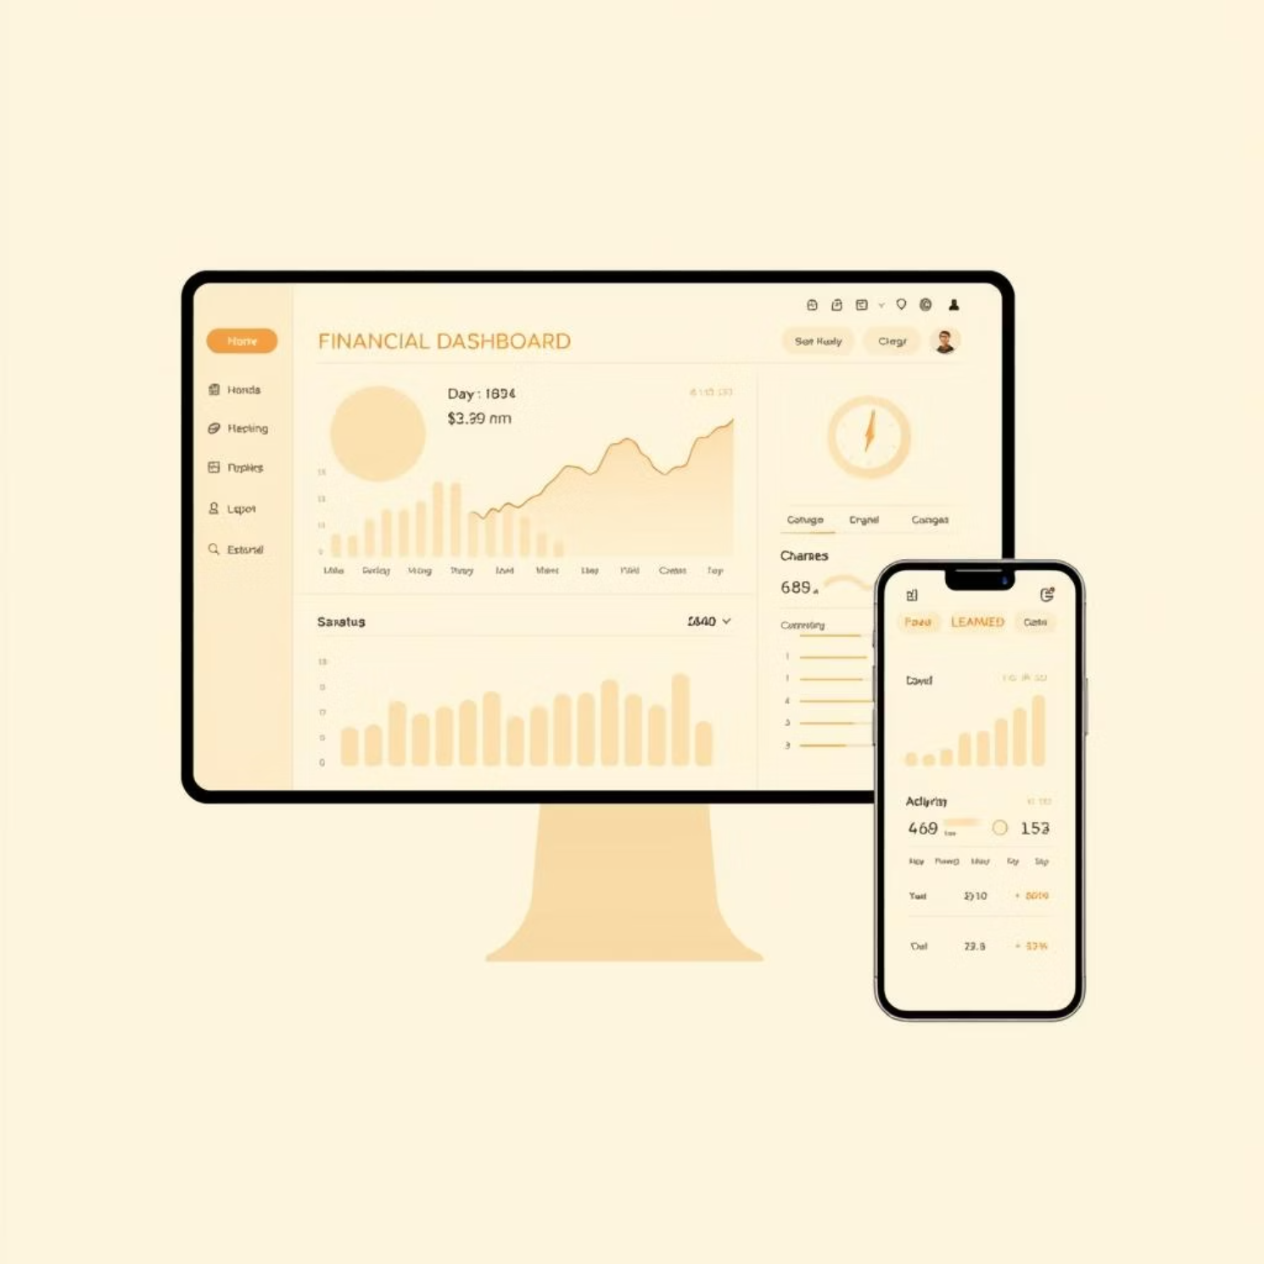
Frontend & UI: Next.js, Tailwind CSS & shadcn/ui
Next.js: React framework providing server-side rendering and static site generation for fast, SEO-friendly interfaces.
Tailwind CSS: Utility-first CSS framework enabling rapid, custom styling with responsive design.
shadcn/ui: Component library built on Tailwind for accessible, consistent UI elements.
Together, they deliver a sleek, responsive, and user-friendly interface for personal finance tracking.
The combination of Next.js, Tailwind CSS, and shadcn/ui allows us to build a high-performance, visually appealing, and highly customisable user interface. This ensures a smooth and intuitive experience for users managing their finances.

Slide 8

Communication & Automation: Inngest & Resend
Inngest: Event-driven serverless functions to handle asynchronous workflows like sending notifications or processing transactions.
Resend: Reliable email delivery service for transactional emails such as alerts, reminders, and reports.
This combination ensures timely communication and smooth background processing without blocking user interactions.
Inngest enables us to build resilient and scalable background processes for tasks like generating monthly reports or sending overdue bill reminders. Resend ensures that these critical communications reach users reliably and on time, enhancing the overall user experience.

Slide 9

Questions?
We've covered the core technologies that power our advanced personal finance tracking system. We are confident that this robust and modern tech stack will provide a secure, efficient, and user-friendly experience for all our users. Now, we open the floor to any questions you may have.

Slide 10

Thank You!
We appreciate your time and attention. We are excited about the future of personal finance management and believe our system will make a significant impact on users' financial well-being.

